Slide 1


Brian Mulchrone
Competency Portfolio
www.infratec-uk.com

Slide 2
Competency Summary
Category | Accreditation Body | No. | Expiry
Highway Electrical Registration Scheme (HERS) | CSCS | H0244064 | 25/09/2026
Slinger / Signaller | ALLMI | 67506 | 19/10/2028
Emergency First Aid at Work | Qualsafe Awards | 3500771 | 30/10/2027
1b Powered Access Licence | IPAF | OP/1949870 | 31/03/2026
Confined Space Safe Entry & Self Rescue | IIRSM | CS-02 10061 | 12/02/2026
Working at Height Level 2 (RQF) | Qualsafe Awards | 3021036 | 15/02/2026
National Highways Safety Passport | National Highways | 14-00013960 | 22/01/2026
Safe Moving and Handling | Qualsafe Awards | 603/2744/3 | 20/03/2028
www.infratec-uk.com

Slide 3
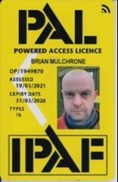
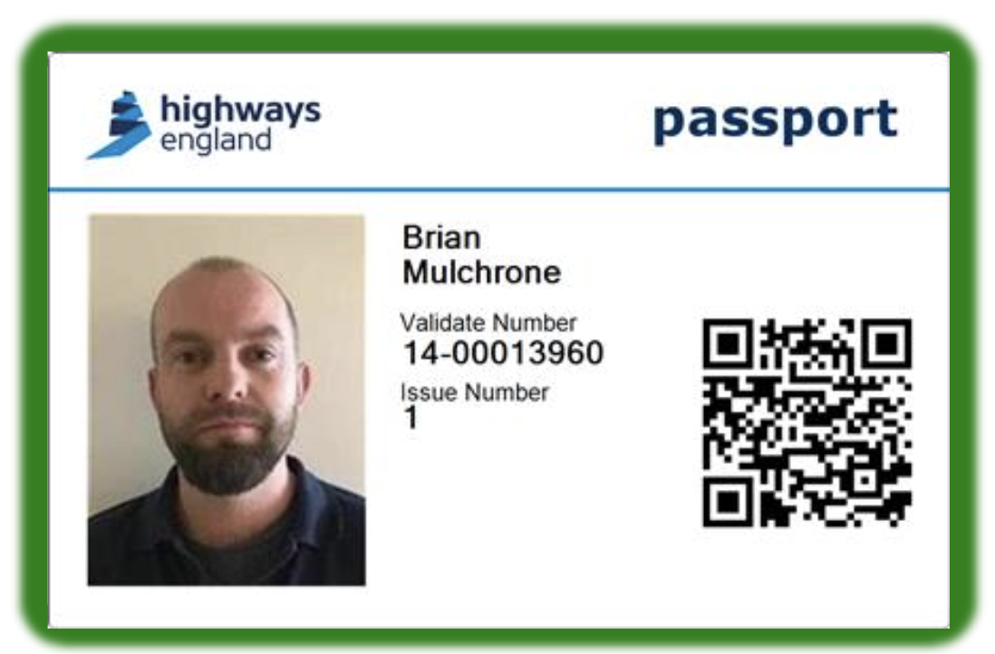
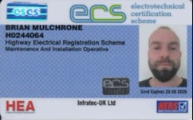
Competency Cards
ECS
IPAF
Safety Passport
www.infratec-uk.com

Slide 4
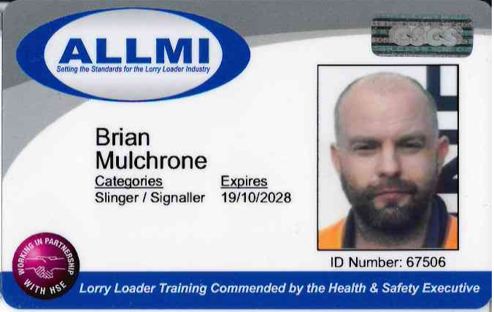
Competency Cards
ALLMI
www.infratec-uk.com

